Slide 1
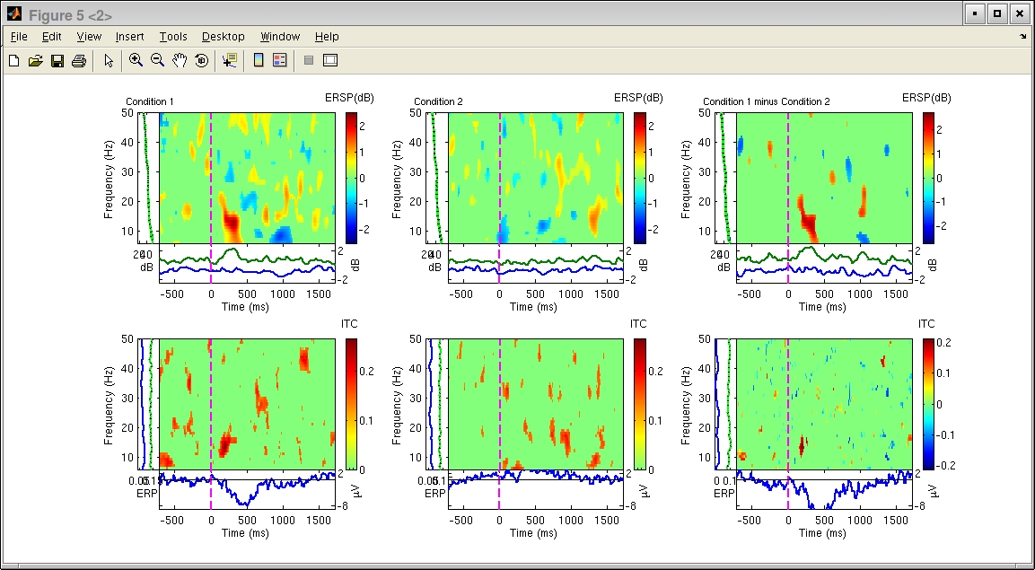
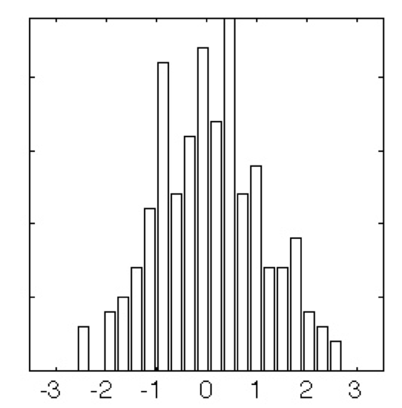
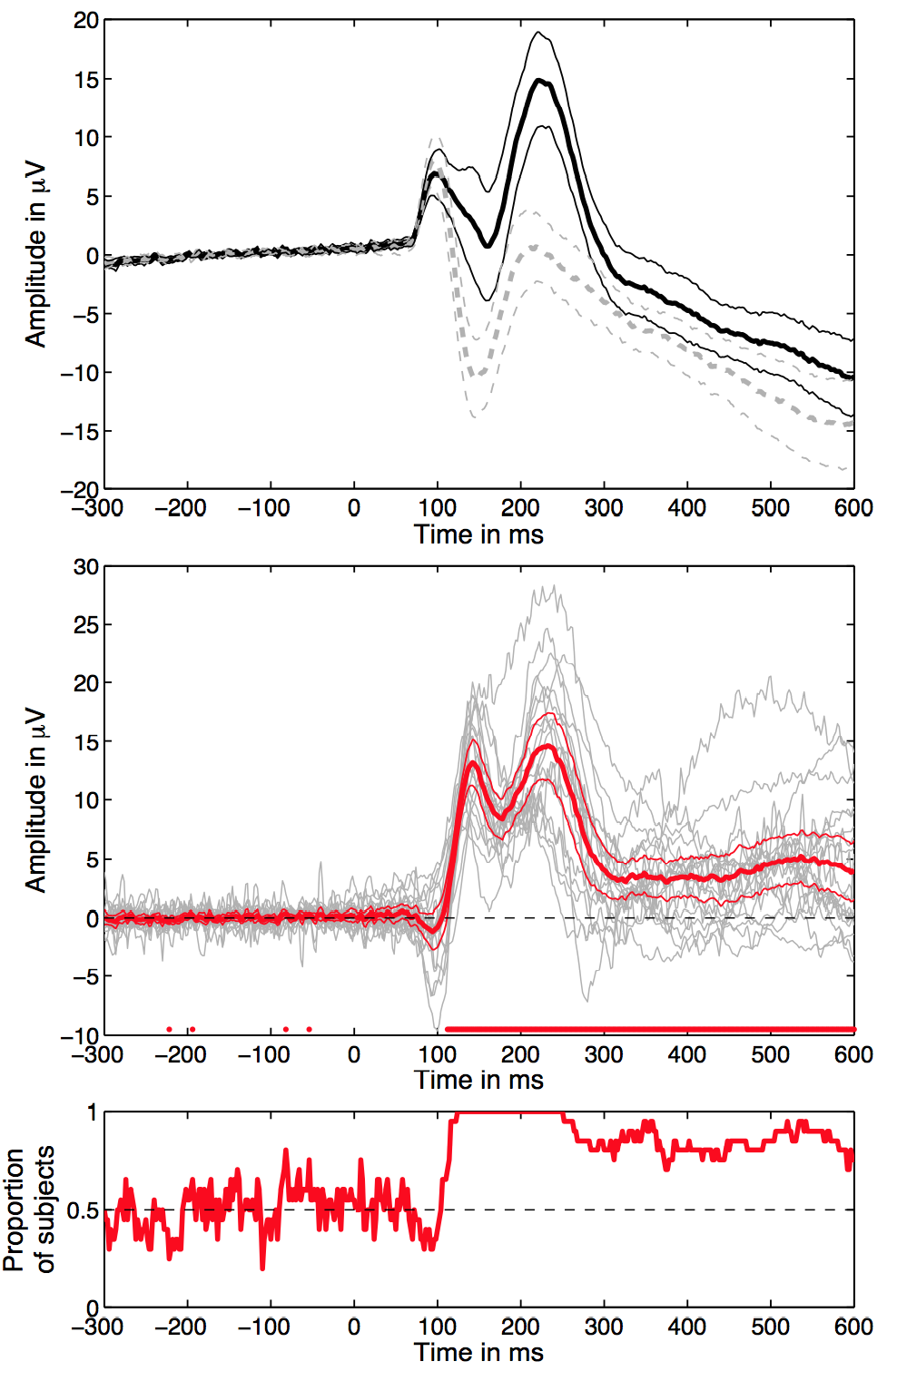
Robust statistics applied to EEG data
Arnaud Delorme

Slide 2
Robust statistics outline
Parametric & non-parametric statistics
How to increase robustness
Bootstrap and permutation methods
Correction for multiple comparisons
Statistical analysis using GLMs

Slide 3
Take-home messages
Look at your data! Show your data!
A perfect & universal statistical recipe does not exist
Keep exploring

Slide 4

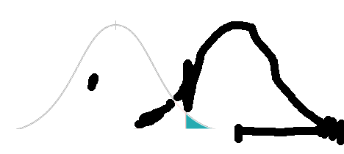
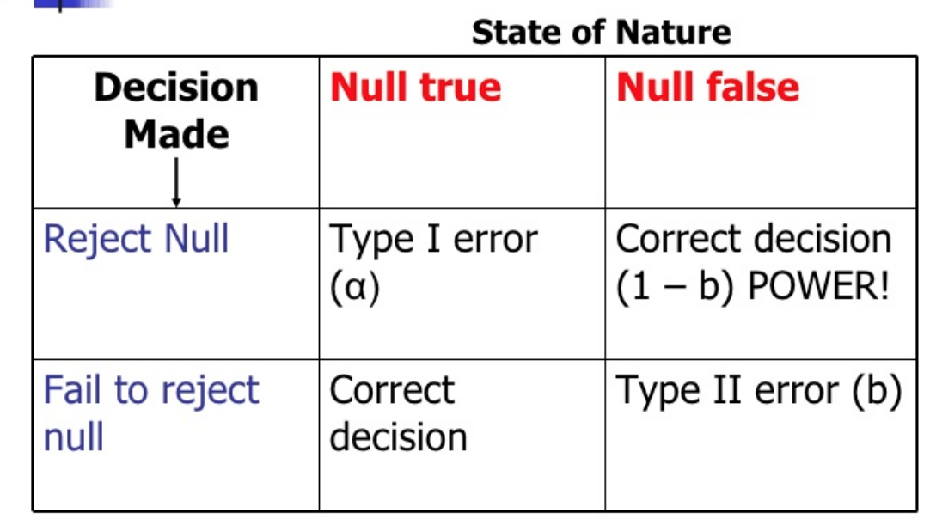
Inferential statistics
Null hypothesis (2 conditions):
e.g. no difference between 2 sets of values
Compare actual difference between average of 2 sets with the null distribution
If in the tail, significant
Type I error: we incorrectly reject the null hypothesis (p-value)
Type II error: we incorrectly accept the null hypothesis
Power is 1 – type II error (usually 0.8 or 0.9)
Effect size is difference of the mean divided by
the pooled standard deviation (Cohen’s d)
Null distribution
Threshold so type I error is 5% of area
H0
Type I error
0
Actual measure (e.g. difference)
Yai p-value below 0.05, done!

Slide 5
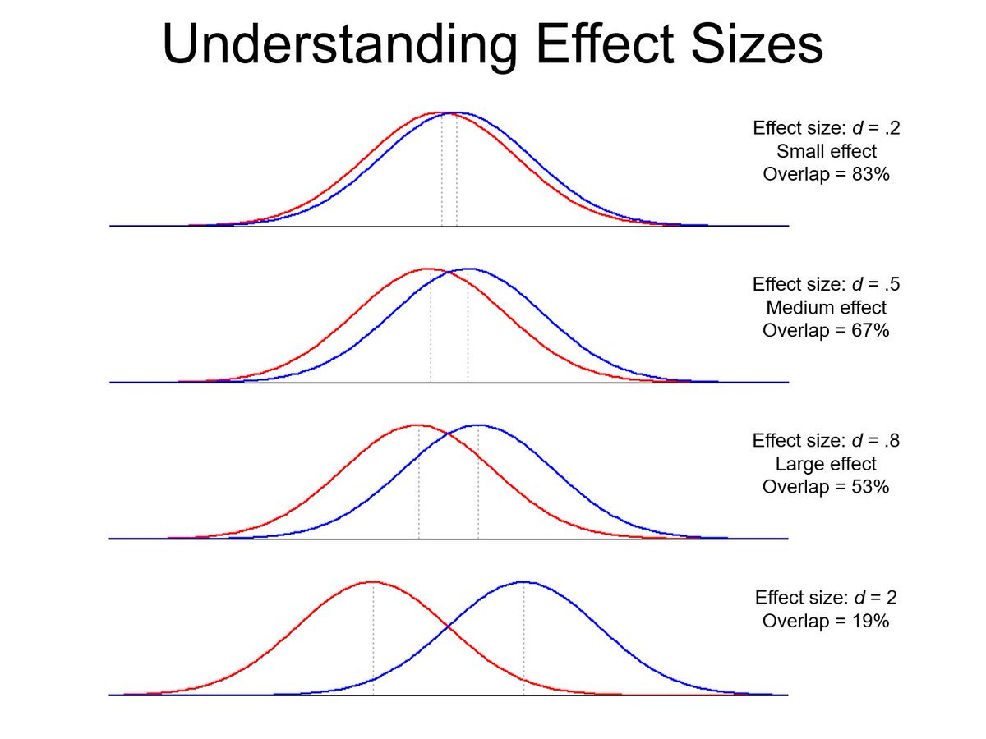

Slide 6
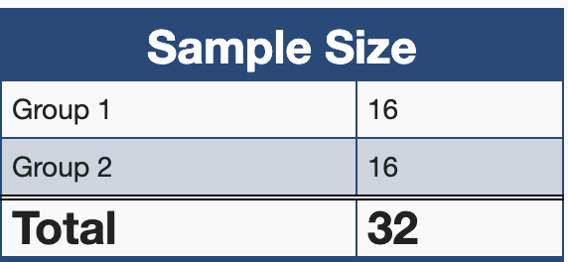
Sample size: power calculation
Calculate the sample size you will need for your experiment
Group 1
Desired alpha
Group 2
Statistical power
https://clincalc.com/stats/samplesize.aspx
Sampsizepwr function in Matlab; Sempower package in R
For group analysis in neuroimaging, sample sizes usually range from 16 to 32

Slide 7
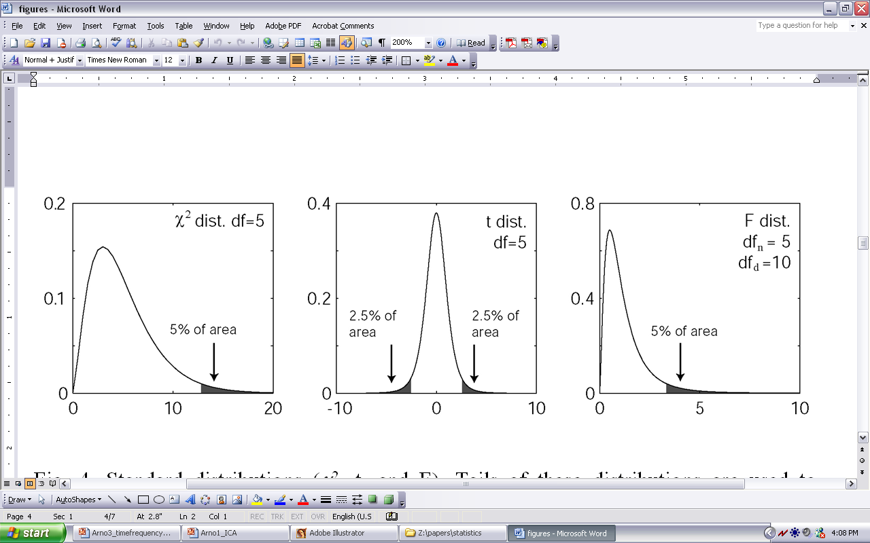
Parametric statistics
T-test: Compare paired/unpaired
Samples for continuous data.
Paired
Unpaired
ANOVA: compare several
groups (can test interaction
between two factors for the
repeated measure ANOVA)
Assume gaussian distribution of data

Slide 8
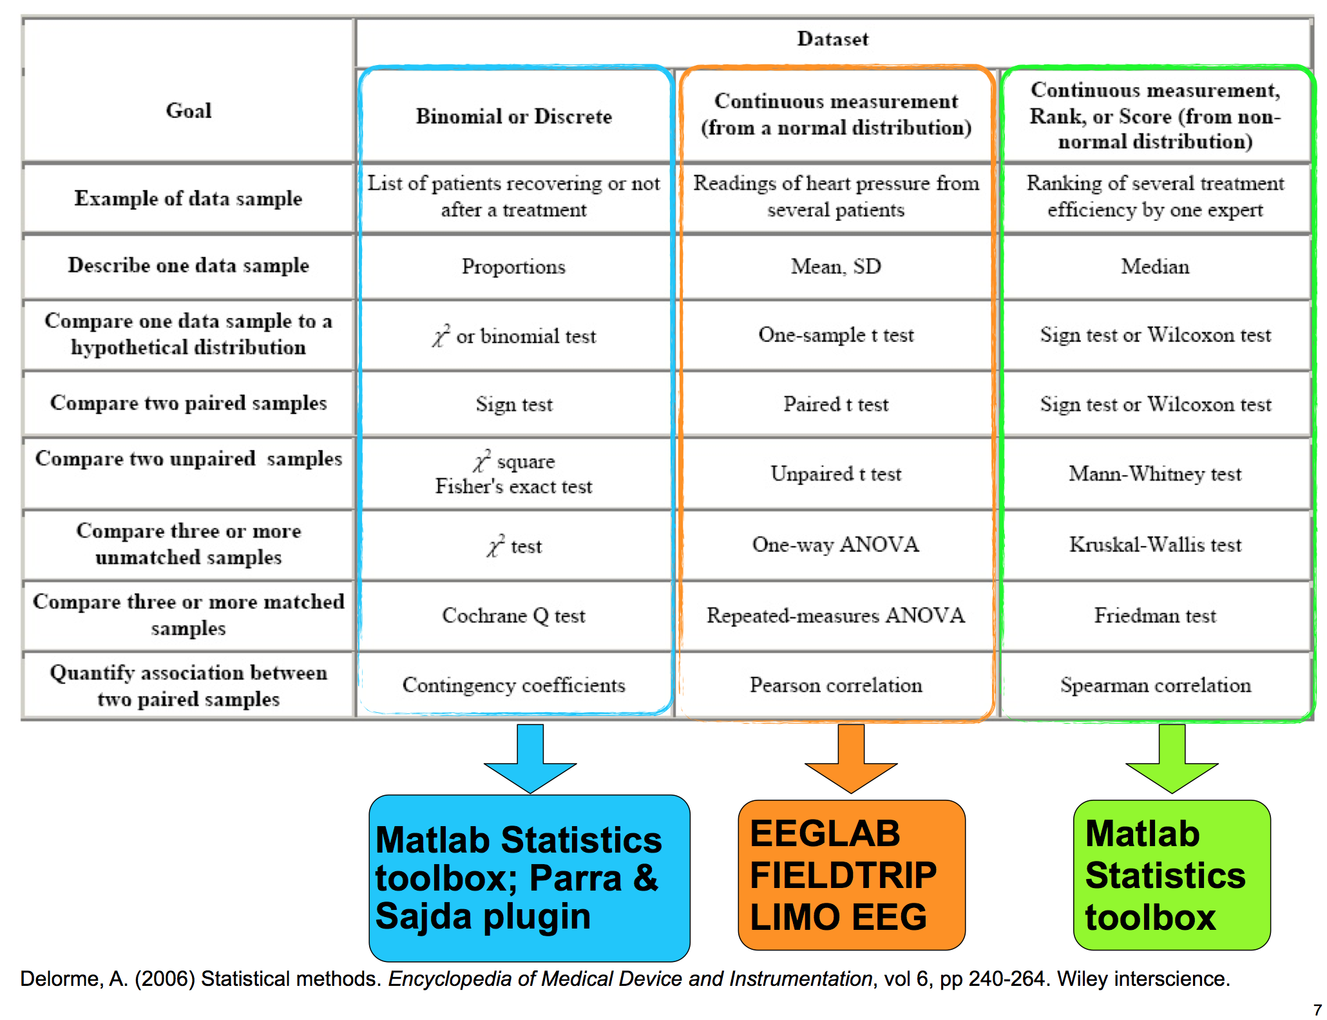
Binomial
Param.
Rank
Delorme, A. (2005) Statistical Methods. Encyclopedia of Medical Device and Instrumentation, vol 6, pp 240-264. Wiley interscience.

Slide 9
Non-parametric statistics
Values
Ranks
Paired t-test Wilcoxon
Unpaired t-test Mann-Whitney
One way ANOVA Kruskal Wallis
BOTH ASSUME NORMAL DISTRIBUTIONS
Need to check the normality of the distribution/rank

Slide 10
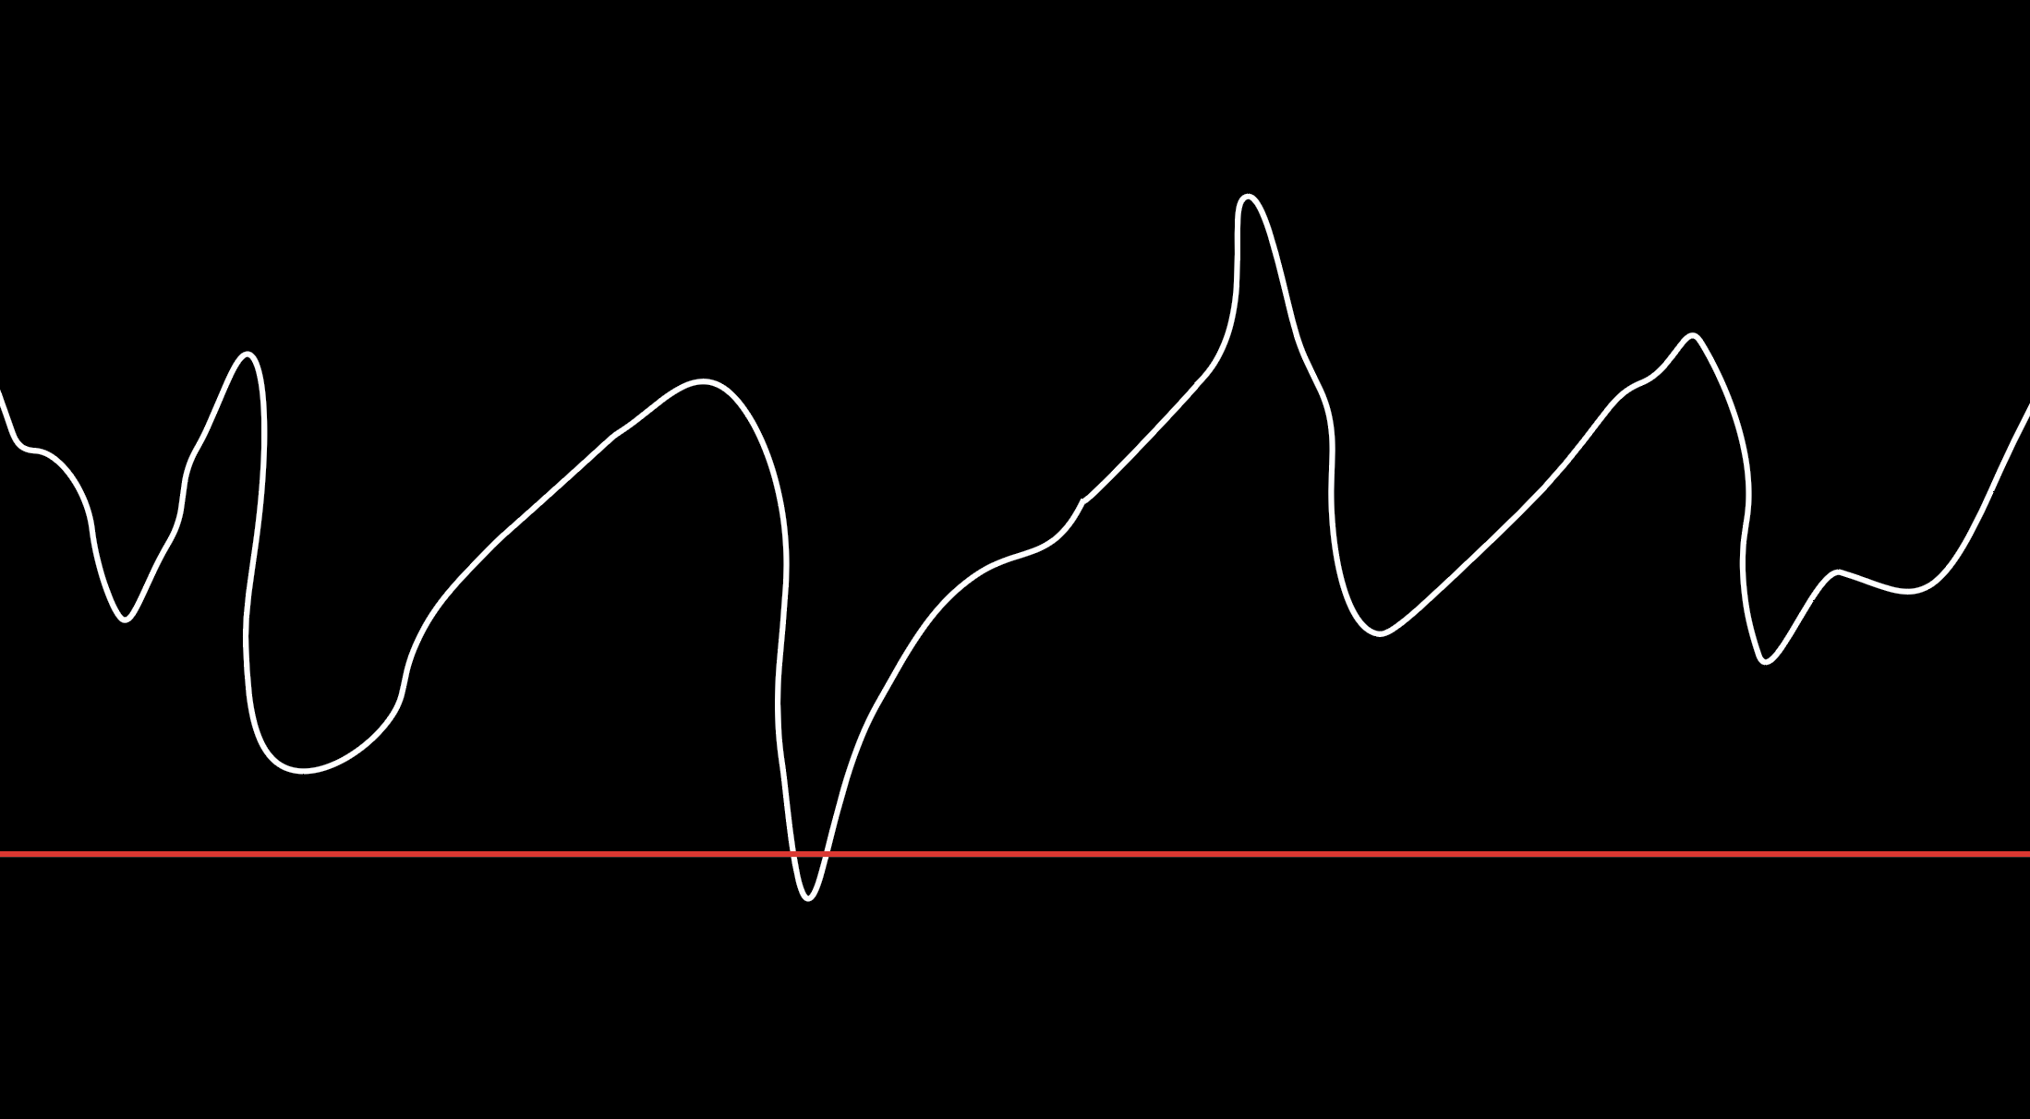
Improving robustness
Optional stopping
(do not do it)
p-value
0.05 threshold
Let’s stop here, Yai!
Number of participants
in statistical analysis

Slide 11
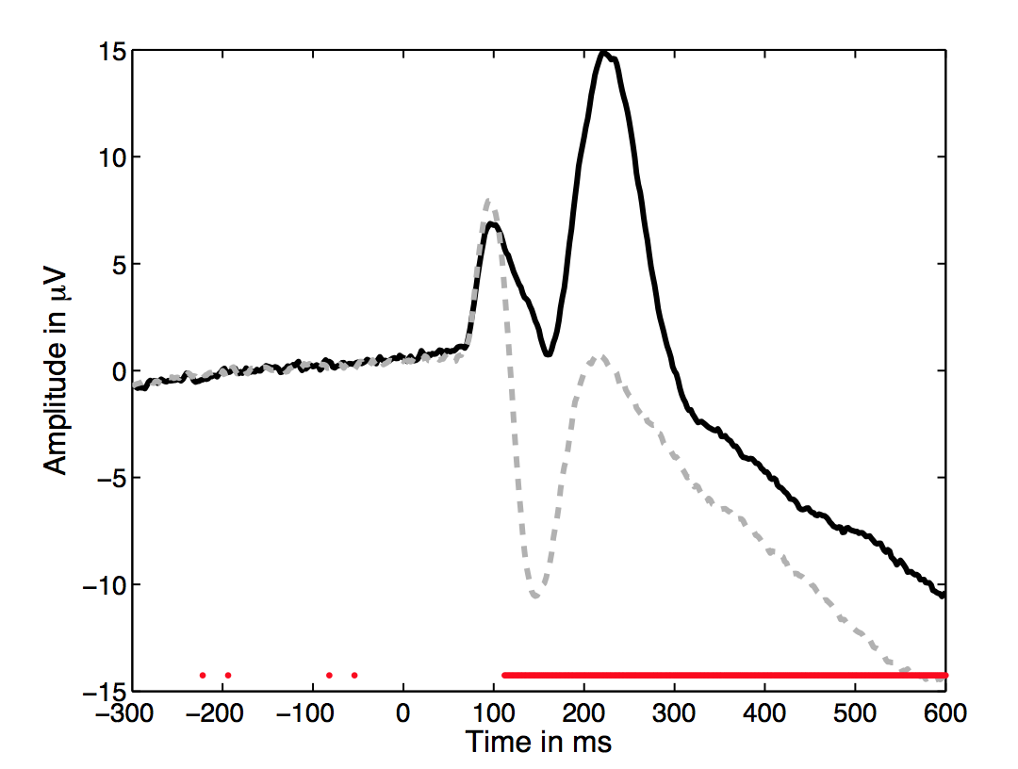
Why the standard figure is not good enough
How many subjects?
Condition 1
Effect size?
Statistical power?
Condition 2
Easy to overinterpret
Significance
Credit: G. Rousselet

Slide 12
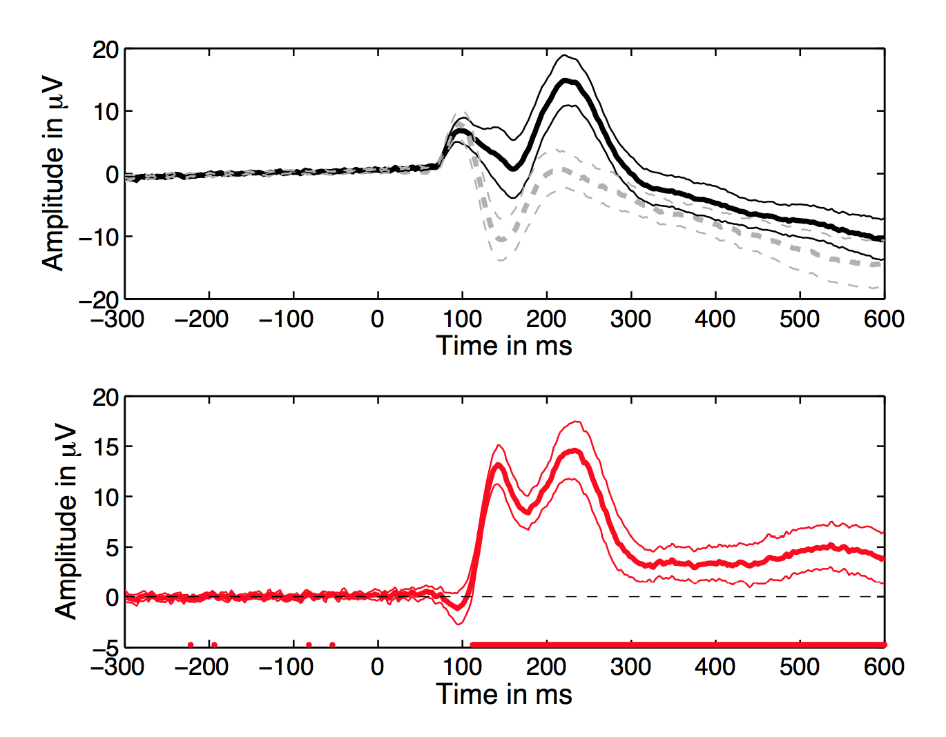
Add confidence intervals and plot of the difference
Credit: G. Rousselet

Slide 13
How many subjects show an effect in the right direction?

Slide 14
Robust measures of central tendency
Non-robust estimator
Mean: mERP = mean(EEG.data,3)
(EEG.data is an array of channels x times x trials)
Robust estimators of central tendency
Median: mdERP = median(EEG.data,3)
Trimmed mean: tmERP = trimmean(EEG.data,20,’round’,3)
20% trimmed means provide high statistical power in the presence of outliers
Rand Wilcox, 2012, Introduction to Robust Estimation and Hypothesis Testing, Elsevier

Slide 15
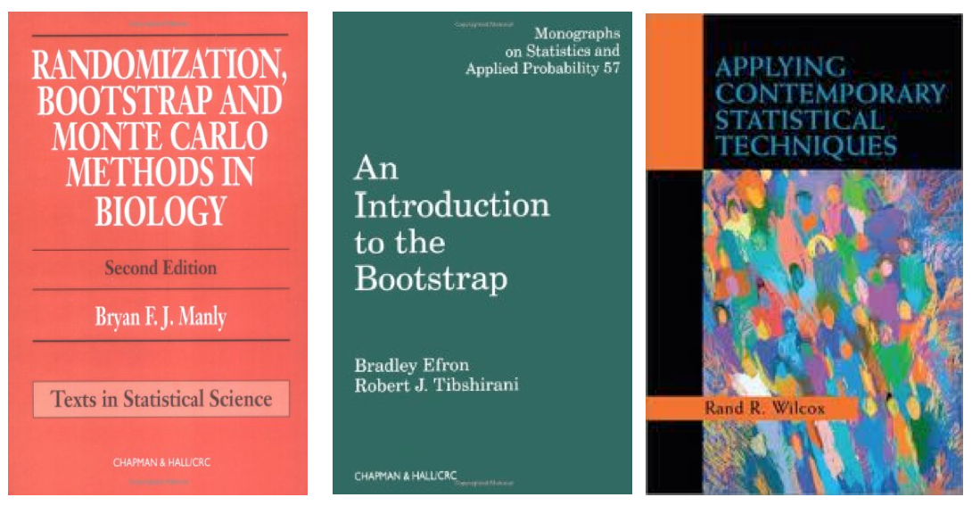

Problems
Not resistant against outliers
For ANOVA and t-test non-normality is an issue when distributions differ or when variances are not equal.
Slight departure from normality can have serious consequences
Solutions
Randomization approach
Bootstrap approach

Slide 16
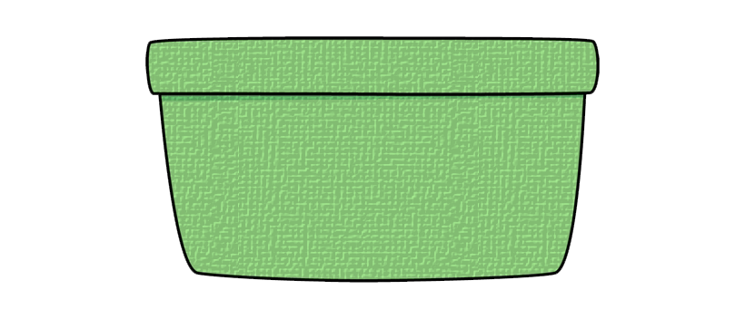
The Bootstrap approach
a7
a2
analyze
b3
b3
a5
b3
difference
X_{i}
a1
b1
b6
a3
a2
b7
a7
analyze

Slide 17
Bootstrap: central idea
“The bootstrap is a computer-based method for assigning measures of accuracy to statistical estimates.” Efron & Tibshirani, 1993
“The central idea is that it may sometimes be better to draw conclusions about the characteristics of a population strictly from the sample at hand, rather than by making perhaps unrealistic assumptions about the population.” Mooney & Duval, 1993

Slide 18
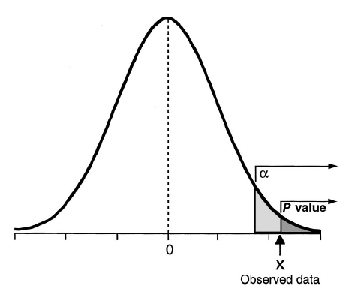
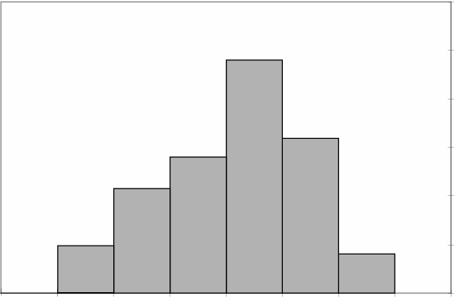
Sample and population
Mean and
Standard deviation
PDF of population when using parametric statistics
Sample
PDF of population when using bootstrap statistics
Given that we have no other information about the population, the sample is our best single estimate of the population.
PDF: Probability density distribution

Slide 19
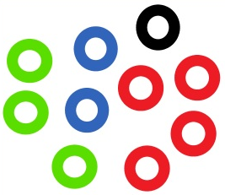
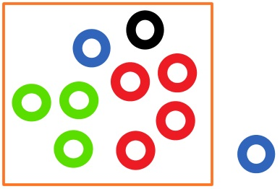
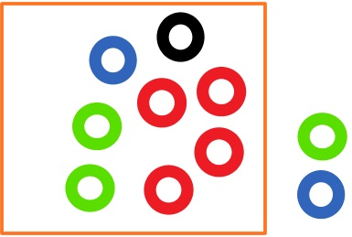
Percentile bootstrap: general recipe
sample = X1, ..., Xn
resample n observations with replacement
compute estimate
repeat B times
With B large enough the B estimates provide a good approximation of the distribution of the estimate of the sample
Estimate
Estimate
Estimate
…

Slide 20
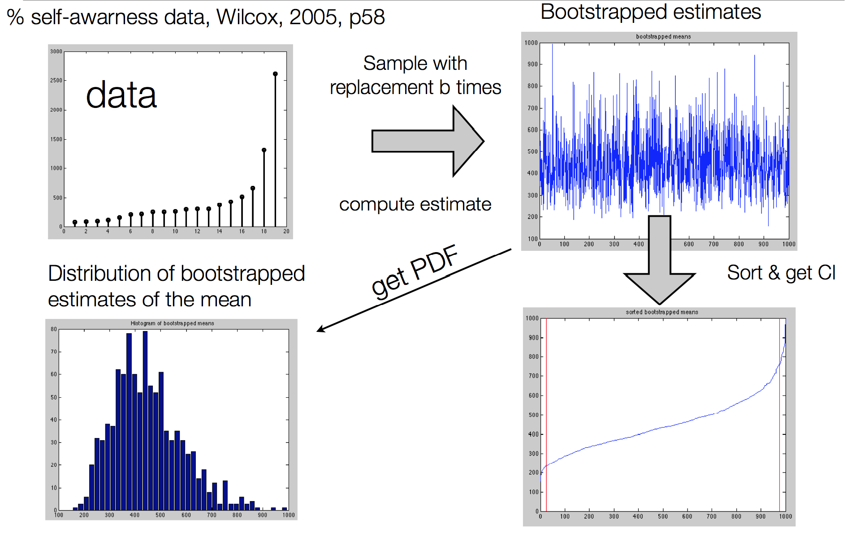
Percentile bootstrap estimate
of confidence intervals
Parametric statistics
CI₉₅ = mean ±1.96*SD

Slide 21
Percentile bootstrap estimate
of confidence intervals
97.5%
Parametric statistics
CI₉₅ = mean ±1.96*SD
2.5%

Slide 22
Distribution can take any shape
2.5%
97.5%
2.5%
97.5%
Once you have the 95% confidence interval, you can perform inferential statistics.

Slide 23
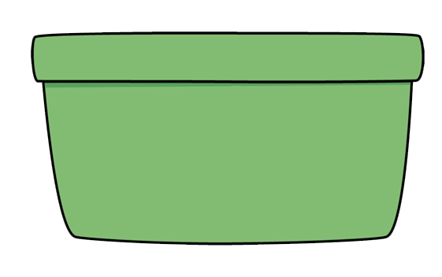
Confidence interval for the difference Bootstrap approach H0
a2
a1
a3
a7
a6
analyze
a4
a5
b2
difference
X_{org}
b1
b3
b7
b6
analyze
b4
b5

Slide 24
Bootstrap approach iteration 1
b3
a3
analyze
b3
difference
X₁
a7
a7
b3
a5
a2
b3
a2
a5
b6
analyze
a1
b3
b3
a1
a3
b1
b6
b1
b1
a2
a2
b7
a7
a7
b7

Slide 25
Bootstrap approach iteration 2
b7
a2
a3
a3
b2
a7
b7
analyze
a3
difference
X₂
a7
a7
b2
b3
a2
b3
a2
a5
b6
analyze
a1
b3
b3
a1
a3
b1
b6
b1
b1
a2
a3
a2
b7
a7
b7

Slide 26
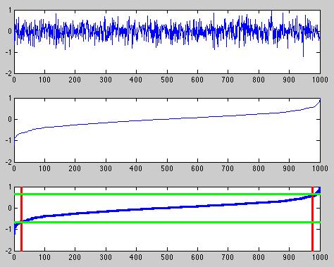
Inferences based on percentile
bootstrap method H0
1000 bootstraps

Slide 27
Inferences based on percentile
bootstrap method H0
1000 bootstraps
Sorted values

Slide 28
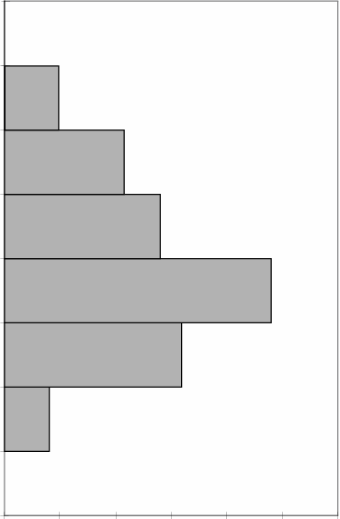
Inferences based on percentile
bootstrap method H0
1000 bootstraps
Sorted values
Doing the same using a Gaussian distribution for the population
→ parametric statistics
Thresholds
2.5%
97.5%

Slide 29
Confidence interval for the difference Bootstrap approach H0 (paired)
a1
a2
a3
a4
a5
a1
a2
a3
a4
a5
Pairwise
Difference
Mean
X_{org}
b1
b2
b3
b4
b5
b1
b2
b3
b4
b5
a1-b1
a2-b2
a3-b3
a4-b4
a5-b5

Slide 30
Confidence interval for the difference Bootstrap approach H0 (paired)
Bootstrap iteration 1
a5-b5
a1-b1
Mean
X₁
a3-b3
a3-b3
a5-b5
Bootstrap iteration 2
a3-b3
a2-b2
a2-b2
Mean
X₂
a4-b4
a4-b4
…
a-b
2.5%
97.5%
0

Slide 31
Measures for the bootstrap
b
b
a
a
a
b
a
t-test
X₂
a
a
b
b
b
a
2.5%
97.5%

Slide 32
Measures for the bootstrap
c
b
a
c
a
b
a
Anova
X₂
c
a
b
b
b
a
a
c
b
c
b
2.5%
97.5%
a

Slide 33

Bootstrap versus permutation
Bootstrap: independent draws
Permutation: dependent draws
Surrogate statistics: our sample is our best estimate of the population
Use bootstrap when possible!

Slide 34
Corrections for multiple comparisons

Slide 35
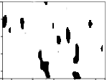
Assessing significance
Original Difference
Difference 1
Difference 2
Difference 3
Difference 4
Frequency
…
Time
Difference mask at p<0.05
2.5%
5%

Slide 36
Correcting for multiple comparisons
• Bonferoni correction
→ divide p-value threshold by the number of comparisons
• Holm-Bonferoni correction
• False Discovery Rate
• Max method
• Clusters

Slide 37
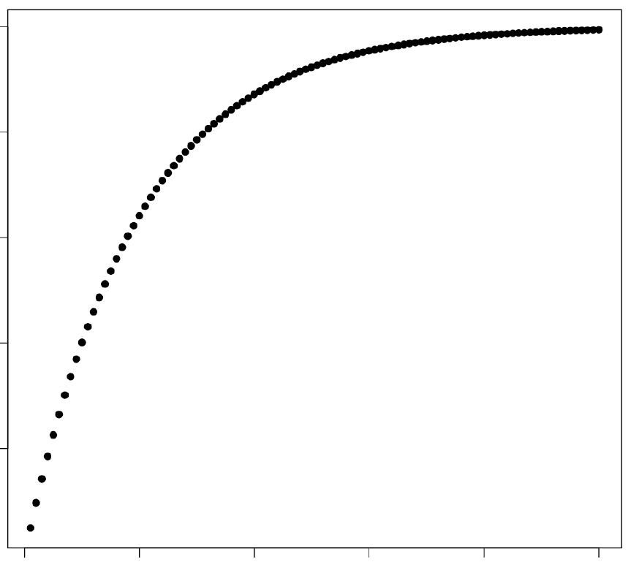
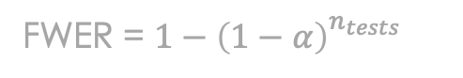
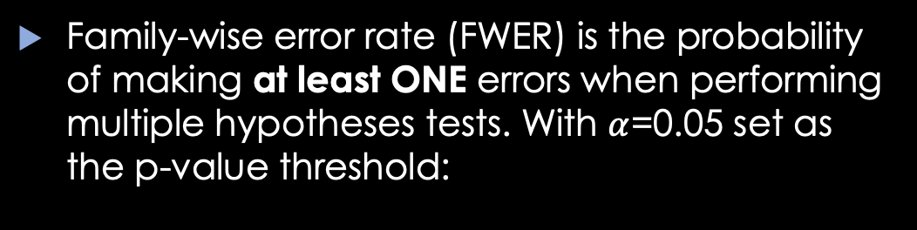
Family-wise error rate
Family-wise error rate (FWER) is the probability of making at least ONE errors when performing multiple hypotheses tests. With $α$=0.05 set as the p-value threshold:
1
1 test → 5%
2 tests → 10%
20 tests → 64%
.64
Family wise error rate
.05
1
20
100
# of tests
FWER = $1−{\left(1−α\right)}_{}^{n_{tests}}$

Slide 38
Holm-Bonferoni’s procedure
Bonferoni
C1
C2
C3
Holm’s
Holms
Index "j" | Actual | .05/(10 –j+1) | C2-C1
1 | .001 | .05/10 | -.0040
2 | .002 | .05/9 | -.0036
3 | .010 | .05/8 | .04
4 | .021 | .05/7 | .01
5 | .022 | .05/6 | .01
6 | .045 | .05/5 | .03
7 | .05 | .05/4 | .04
8 | .1 | .05/3 | .08
9 | .2 | .05/2 | .17
10 | .6 | .05 | .55
Uncorrected

Slide 39
FDR procedure
Bonferoni
C1
C2
C3
Holms
Index "j" | Actual | j*0.05/10 | C2-C1
1 | .001 | .005 | -.004
2 | .002 | .010 | -.008
3 | .010 | .015 | -.005
4 | .021 | .020 | .001
5 | .022 | .025 | -.003
6 | .045 | .030 | .015
7 | .05 | .035 | .015
8 | .1 | .040 | .060
9 | .2 | .045 | .155
10 | .6 | .05 | .55
FDR
0.05
FDR
Holm
0.005
Uncorrected
1
10

Slide 40
Holm-Bonfferoni at p=0.05
→ less than 5% chance of having one false positive (family-wise error rate of 5%)
FDR procedure at 0.05
→ at most 0.05% false positives
→ 40% change of observing a false positive for 100 values (family-wise error rate of 40%)

Slide 41
Max procedure (maxT)
Original Difference
Difference 1
Difference 2
Difference 3
Difference 4
…
MAX
MAX
MAX
MAX
Mask at p<0.05
maxT vs minP
5%

Slide 42
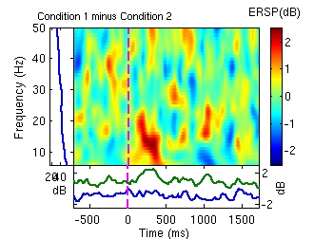
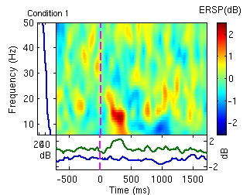
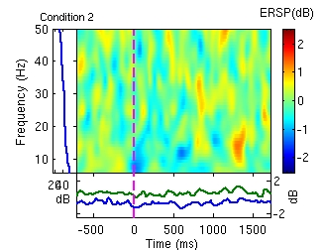
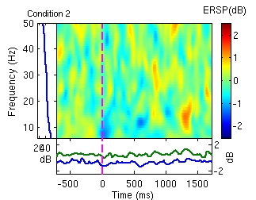
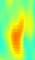
Cluster correction for multiple comparisons
Original difference
Area of significant regions in number of pixels
44 pixels
5%
Difference bootstrap 1
Difference bootstrap 2
Difference bootstrap 3
Region of 35 pixels
23 pixels
22 pixels
….

Slide 43
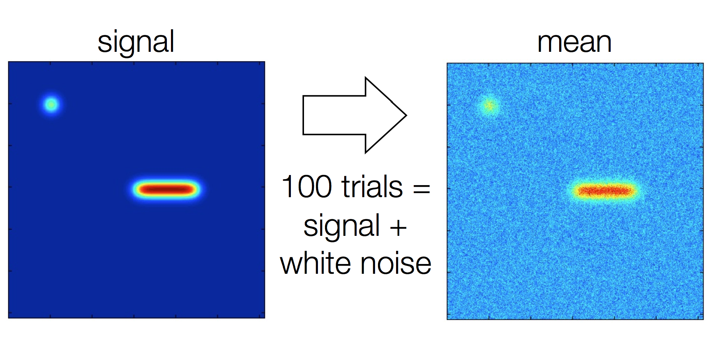
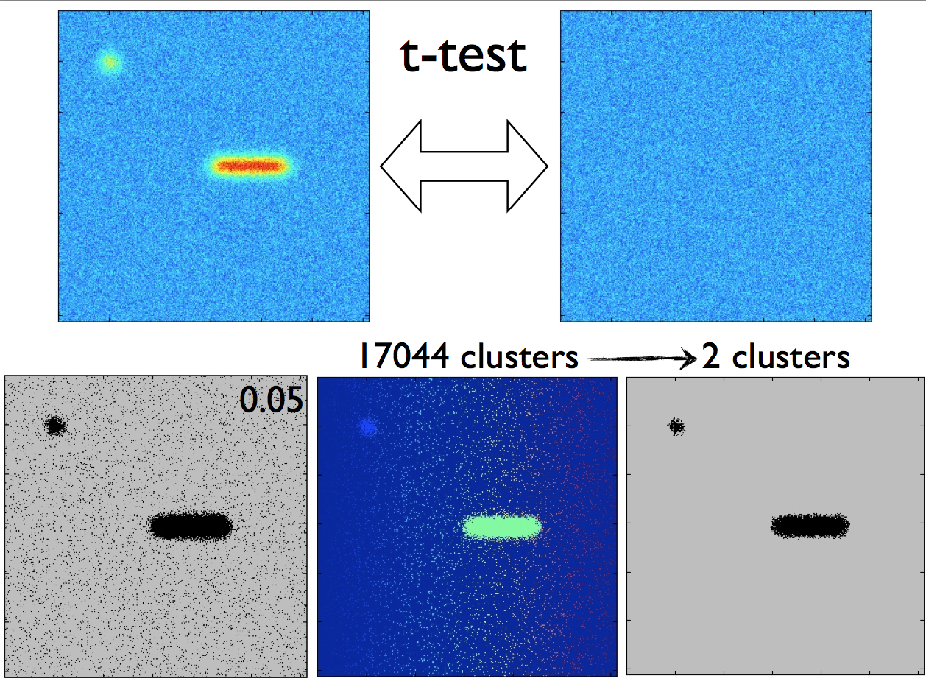
Control for multiple comparisons cluster method example
Mean
Noisy mean
Uncorrected
Corrected (2 clusters)

Slide 44
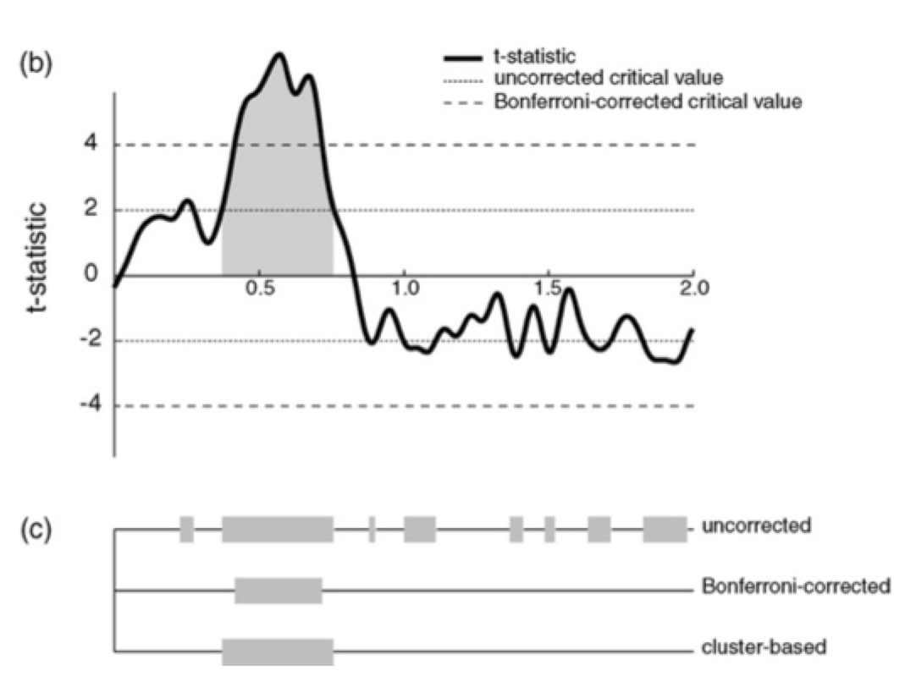
Cluster correction in 1 dimension
Maris and Oostenveld, J. Neurosci. Methods, 2007

Slide 45
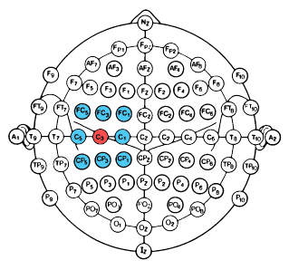
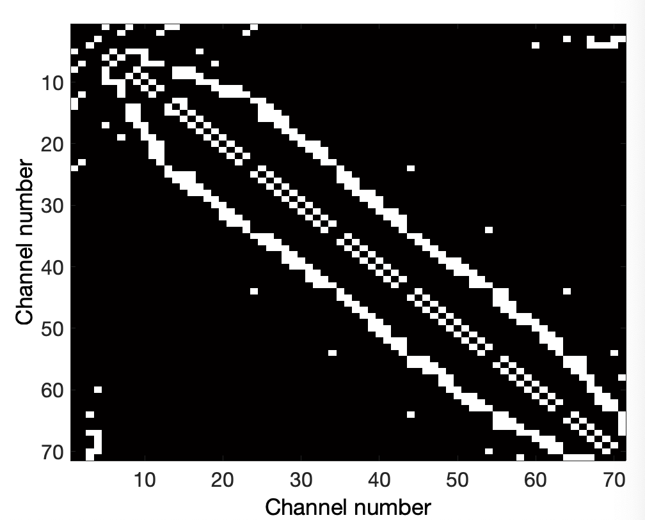
Significant region
Channel neighbors
Channel neighbors matrix

Slide 46
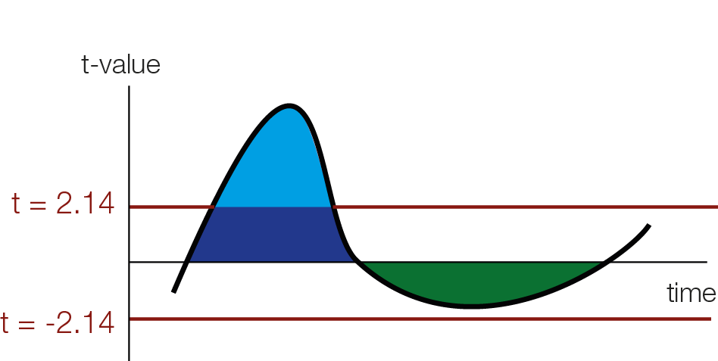
TFCE – threshold free cluster enhancement

Slide 47
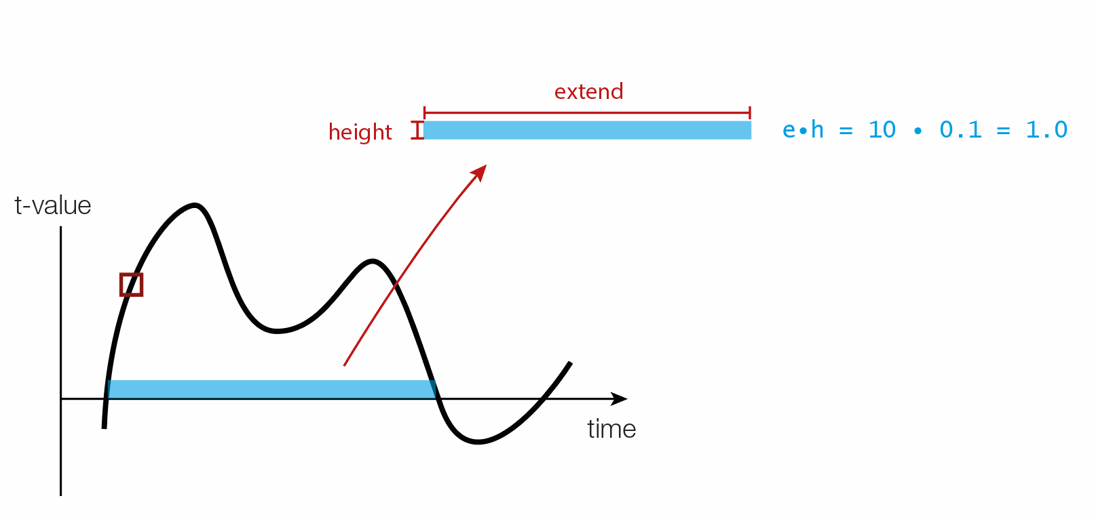
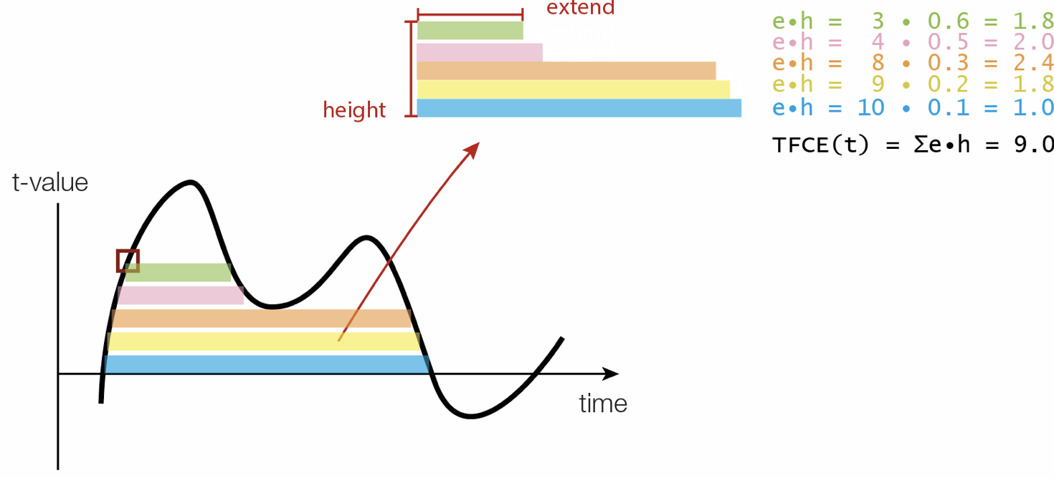
TFCE – threshold free cluster enhancement
Credit: Benedick Ehinger
Smith SM, Nichols TE. Threshold free cluster enhancement: addressing problems of smoothing, threshold dependence and localisation in cluster inference. NeuroImage. 2009.

Slide 48
TFCE – threshold free cluster enhancement
Credit: Benedick Ehinger
Smith SM, Nichols TE. Threshold free cluster enhancement: addressing problems of smoothing, threshold dependence and localisation in cluster inference. NeuroImage. 2009.

Slide 49
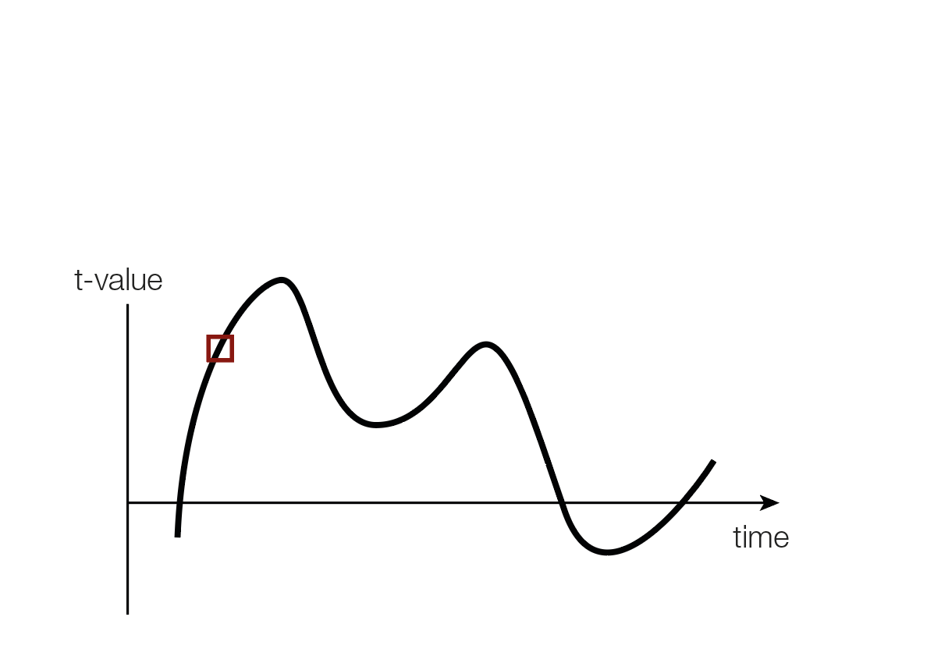
Smith SM, Nichols TE. Threshold free cluster enhancement: addressing problems of smoothing, threshold dependence and localisation in cluster inference. NeuroImage. 2009.

Slide 50
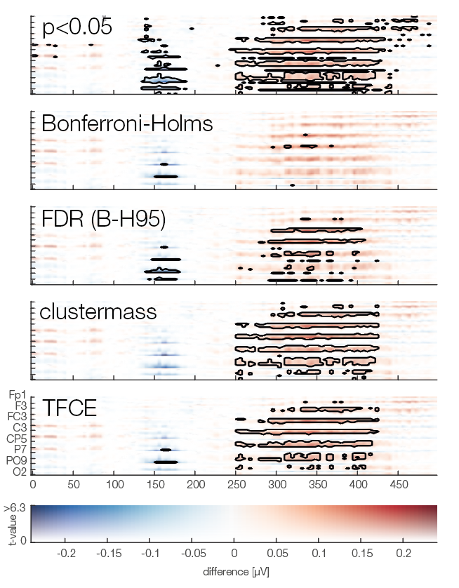
Uncorrected
Bonferroni-Holms
+ Fast
- Samples are not independent, therefore too strong of a correction
FDR
+ Fast
+ Interpretation clear
- Does not control FWER
Cluster
+ Effective use of prior knowledge
+ Appropriately control FWER
- Statistical interpretation limited
- Computationally expensive
TFCE
+ Effective use of prior knowledge
+ No initial threshold
+ Appropriately control FWER
- Statistical interpretation limited
- Very computationally expensive
Ehinger & Dimigen. PeerJ. 2019 Oct 24;7:e7838. doi: 10.7717/peerj.7838.

Slide 51
References
Delorme, A. 2006. Statistical methods. Encyclopedia of Medical Device and Instrumentation, vol 6, pp 240-264. Wiley interscience.
Genovese et al. 2002. Thresholding of statistical maps in functional neuroimaging using the false discovery rate. NeuroImage, 15: 870-878
Nichols & Hayasaka, 2003. Controlling the familywise error rate in functional neuroimaging: a comparative review. Statistical Methods in Medical Research, 12:419-446
Maris, 2004. Randomization tests for ERP topographies and whole spatiotemporal data matrices. Psychophysiology, 41: 142-151
Maris et al. 2007. Nonparametric statistical testing of coherence differences. Journal of Neuroscience Methods, 163: 161-175
Groppe, D.M., Urbach, T.P., & Kutas, M. (2011) Mass univariate analysis of event-related brain potentials/fields I: A critical tutorial review. Psychophysiology, 48(12) pp. 1711-1725.
Thanks to G. Rousselet

Slide 52
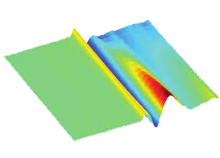

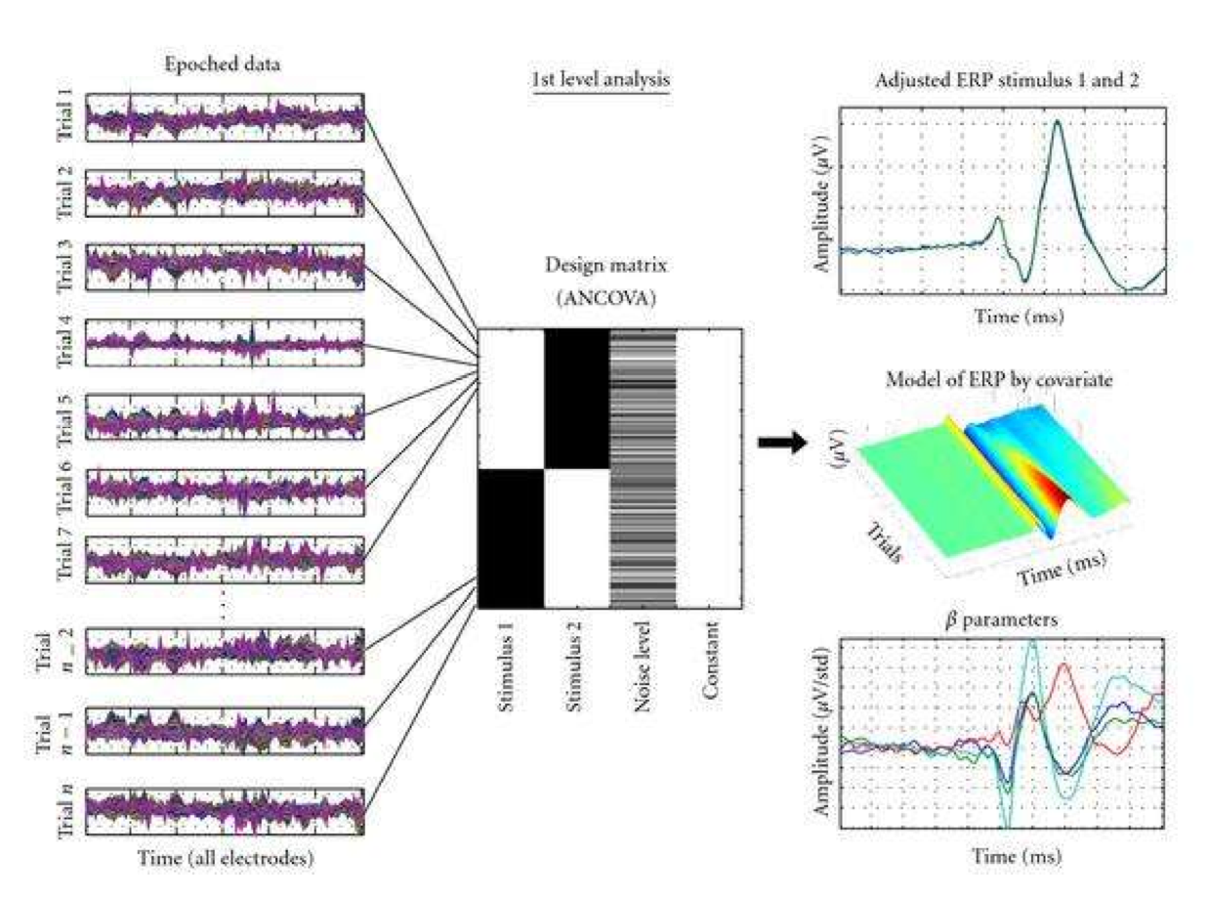
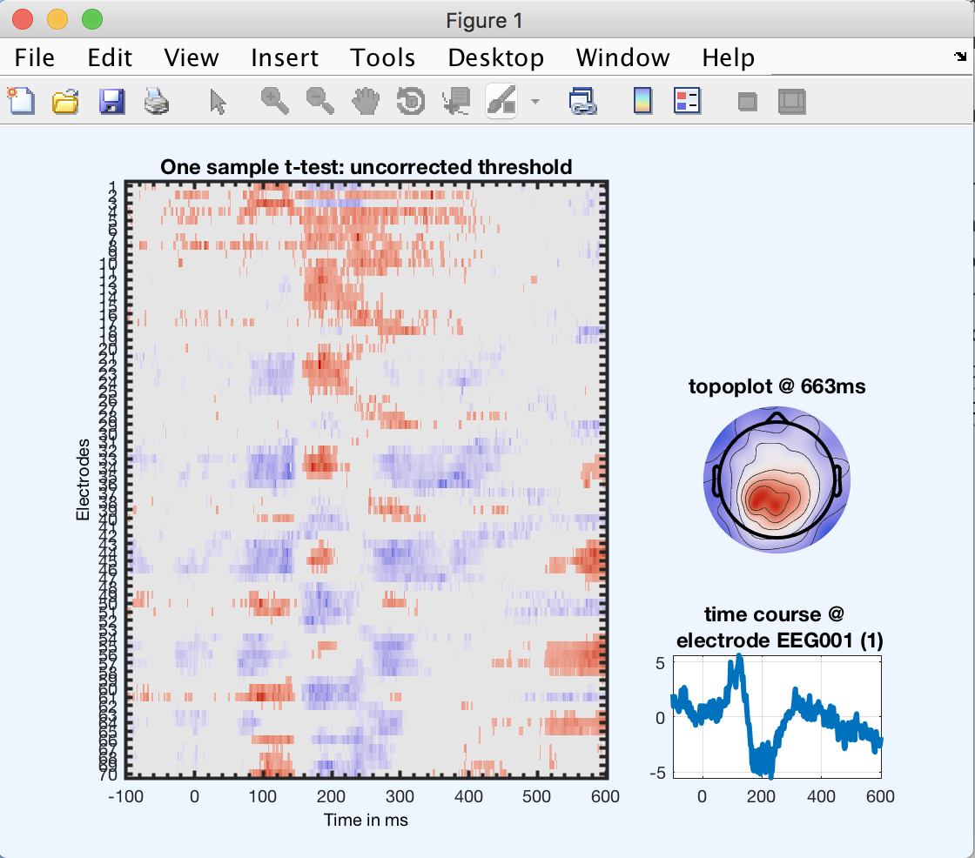
General Linear Modeling in EEG
Cyril Pernet

Slide 53
The GLM family
Slide from Tor Wager

Slide 54
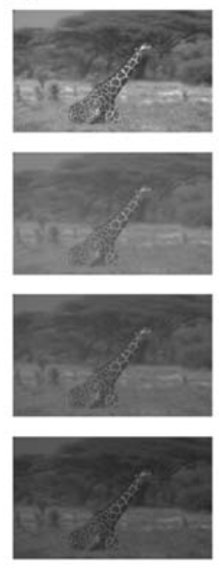
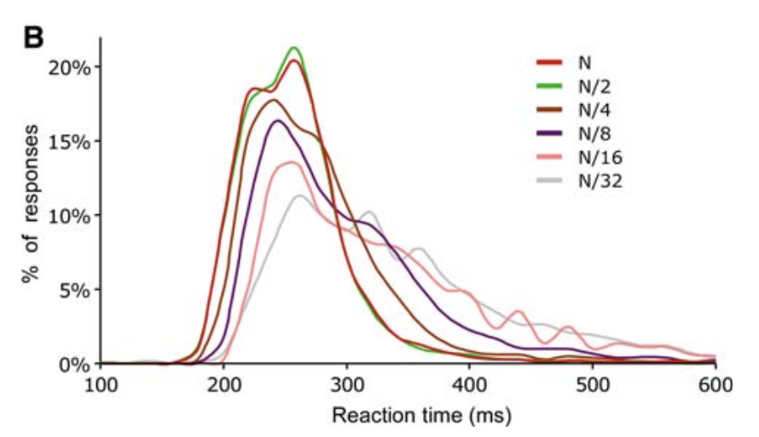
A regression is a linear model
Varying factor: Luminance of image
Outcome: Reaction time
Mace, M., Delorme, A., Richard, G., Fabre-Thorpe, M. (2010) Spotting animals in natural scenes: efficiency of humans and monkeys at very low contrasts. Animal Cognition, 13(3):405-18.

Slide 55
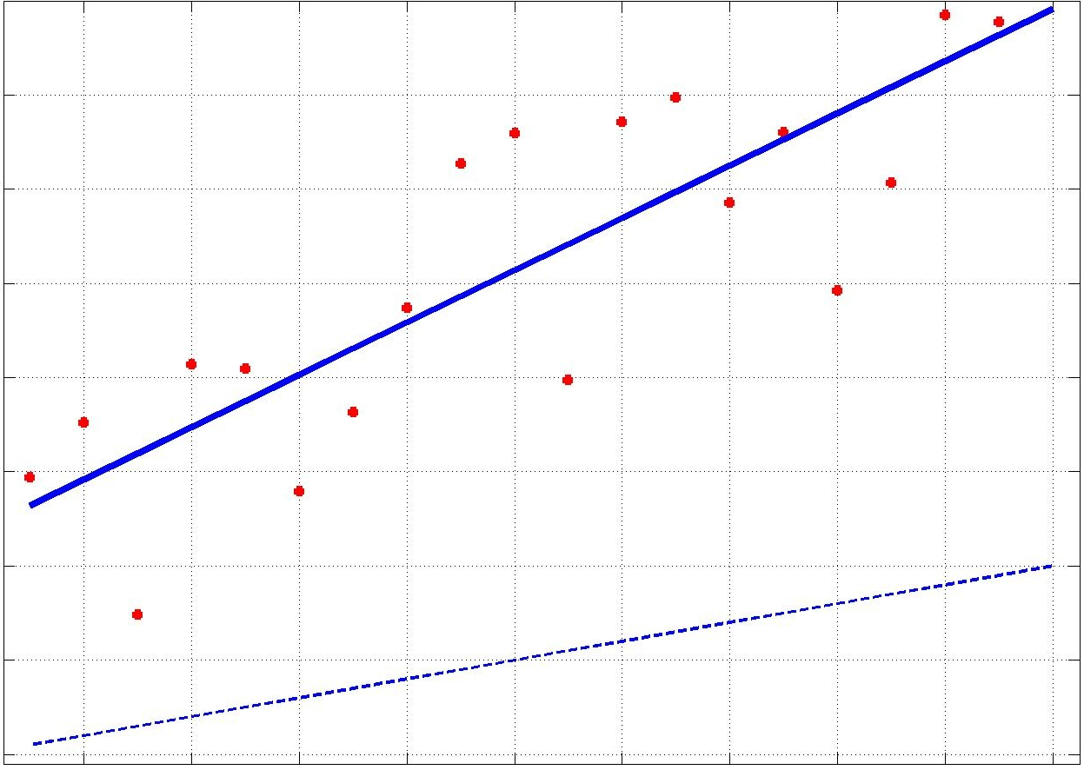
A regression is a linear model
RT (ms)
Given an experimental measure x (e.g. luminance)
We collect data RT (e.g. reaction time)
Model: RT = β₀+xβ₁+ ε
Do some maths / run a software to find β₁ and β₀
RT = 23.6 + 2.7x
Luminance attenuation
>

Slide 56
A regression is a linear model
RT (ms)
For each trial
RT₁ = β₀ +10*β₁ + ε₁
RT₂ = β₀ + 5*β₁ + ε₂
RT₃ = β₀ + 7*β₁ + ε₃
…
Luminance level
Luminance attenuation
To test for significance compare the original regression model RT_{i} = β₀ + c_{i}*β₁ + ε_{i} with the simplified model RT_{i} = β₀ + ε_{i}
Compare the fit
Test if 0 included in confidence interval

Slide 57
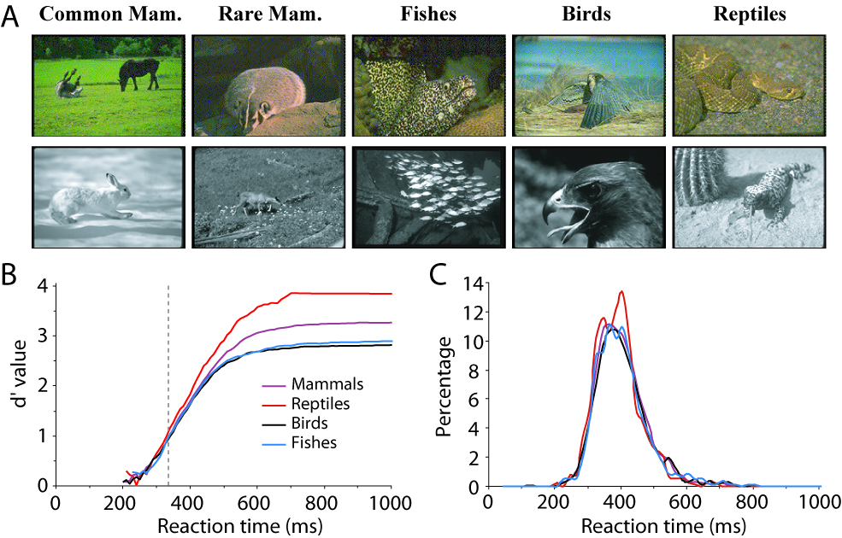
An ANOVA is a linear model
Varying factor: Type of image
Outcome: Reaction time (go/no-go)
No-animal
Delorme, A., Richard, G., Fabre-Thorpe, M. (2010). Key visual features for rapid categorization of animals in natural scenes. Frontier in psychology, 1:21

Slide 58
RT_{i,j} = β₀ + β_{i} + ε_{i,j}
that is to say the data (e.g. RT) = a constant term (grand mean β₀) + the effect of a treatment (β₁ for fishes 1 and β₂, β₃ for birds and reptiles) and the error term (ε_{i,j})
For trial 4 (for example first trial of birds) we have
RT_{2,1} = β₀ + 0*β₁ + 1*β₂ + 0*β₃ + ε_{2,1}
For trial 13 (for example second trial of birds) we have
RT_{2,2} = β₀ + 0*β₁ + 1*β₂ + 0*β₃ + ε_{2,2}
This is a GLM that is equivalent to an ANOVA
Statistics: if there is an effect of treatment then error of the simplified model RT_{i,j} = β₀ + ε_{i,j} should be lower than the original model RT_{i,j} = β₀ + β_{i} + ε_{i,j}
Compare the fit

Slide 59
A GLM can do both a Regression and an ANOVA (ANCOVA)
Varying factor: Type of image AND luminance
Outcome: Reaction time (go/no-go)
No-animal
For example, for trial (first bird with lumiance c_{2,1}) we have
RT_{2,1} = β₀ + 0*β₁ + 1*β₂ + 0*β₃ + 0*β₃ + c_{2,1}*β₄ + ε_{2,1}
Categorical var.
ANOVA
Continous var.
REGRESSION

Slide 60
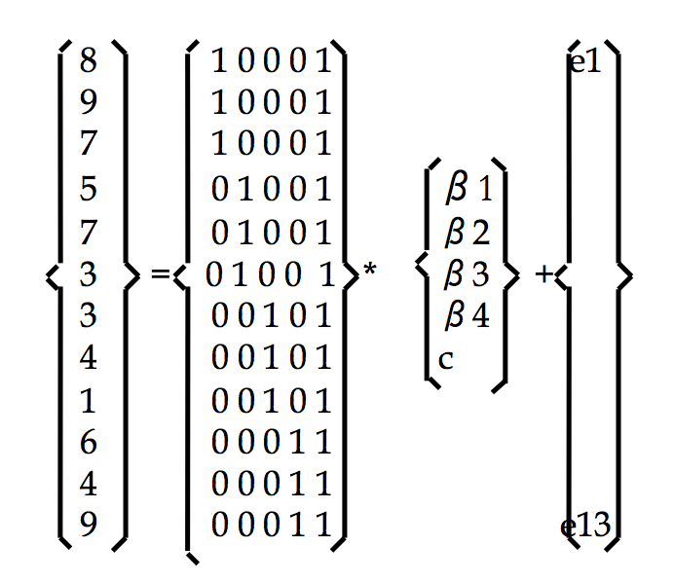

The design matrix
y(1..3) = 1xβ1+0xβ2+0xβ3+0xβ4+c+error
y(4..6) = 0xβ1+1xβ2+0xβ3+0xβ4+c+error
y(7..9) = 0xβ1+0xβ2+1xβ3+0xβ4+c+error
y(10..12) = 0xβ1+0xβ2+0xβ3+1xβ4+c+error
Y | Gp
8 | 1
9 | 1
7 | 1
5 | 2
7 | 2
3 | 2
3 | 3
4 | 3
1 | 3
6 | 4
4 | 4
9 | 4
Design matrix
G₁ G₂ G₃ G₄ C
Y = D * β + ε
Measures
Model/
Design matrix
Unknown
Errors

Slide 61


Linear Modeling of EEG data: level 1
Electrode 1
Continuous var.
Electrode difference
Between conditions
Categorical var.
Significance: bootstrap trials to get confidence interval of βs

Slide 62



Linear Modeling of EEG data: level 1
Electrode 1
Scalp topography of
beta difference
at a given latency
Electrode 2
Scalp topography of
potential difference
(masked using beta signif.)
Electrode 3
Limit of the regions
masked for significance
…

Slide 63
Linear Modeling of EEG data: level 2
Participant 1
chan1
chan2
chan3
chan4
…
Participant 2
Level 2
Standard stats.
2nd level-GLM
…
Participant 3
…
GLM: ordinary least square (OLS)
vs. weighted least square (WLS)
…

Slide 64

Linear Modeling of EEG data: level 2
Level 1
Participant 1
Participant 2
Level 2
2-way ANOVA:
Main effect 1 (shape)
Main effect 2 (color)
Interaction
Participant 3

Slide 65
Stimuli
Or
Or
Or
β1
β2
β3
β4
1. Interaction design
(EEGLAB default)
2. Factorial design
3. Full factorial design
Notes:
Interaction design. Use beta as direct input into repeated measure
ANOVA 2nd level to compute main effect and interaction effect (no need to build contrasts)
Factorial design
shape x color
Simpler to build shape or color contrast
Full factorial design
Good to study interactions in single subjects. No possible interaction between first 4 betas at the 2nd level.

Slide 66
Linear Modeling of EEG data: level 2
Participant 1
Participant 2
Shape:
Group t-test on β○− β□
Color
Group t-test on β✹ − β✹
Interaction
- One sample t-test on β●, β●, β■, β■
Participant 3
…

Slide 67

Linear Modeling of EEG data: level 2
Mixed effect model
(still a GLM)
Hierarchical GLM
Level 1
P1
P2
C
P1
P3
P2
P3
Level 2
vs
Random effects
Fixed effects

Slide 68
The all-powerful mixed model
Y = gender + age + spectral_power_cz_10hz + (1 | subject)
Categorical var.
Continuous vars.
Random effect
Y_{trial_1,s_1} = gender_{s_1} + age_{s_1} + spectral_power_cz_10hz_{trial_1,s_1} + Constant_{s_1} + Error_{trial_1,s_1}
Y_{trial_2,s_1} = gender_{s_1} + age_{s_1} + spectral_power_cz_10hz_{trial_2,s_1} + Constant_{s_1} + Error_{trial_2,s_1}
Y_{trial_3,s_1} = gender_{s_1} + age_{s_1} + spectral_power_cz_10hz_{trial_3,s_1} + Constant_{s_1} + Error_{trial_3,s_1}
…
Y_{trial_1,s_2} = gender_{s_2} + age_{s_2} + spectral_power_cz_10hz_{trial_1,s_2} + Constant_{s_2} + Error_{trial_1,s_2}
Y_{trial_2,s_2} = gender_{s_2} + age_{s_2} + spectral_power_cz_10hz_{trial_2,s_2} + Constant_{s_2} + Error_{trial_2,s_2}
Y_{trial_3,s_2} = gender_{s_2} + age_{s_2} + spectral_power_cz_10hz_{trial_3,s_2} + Constant_{s_2} + Error_{trial_3,s_2}
…

Slide 69
The all-powerful mixed model
Y = gender + age + spectral_power_cz_10hz + (1 | subject)
Categorical var.
Continuous vars.
Random effect
MATLAB: model = fitglme(df, y ~ pred1 + (1|subject)');
Python: model = Lmer(‘y ~ pred1 + (1|subject)', data=df)
R: model <- glmer(y ~ pred1 + (1|subject), data = df)

Slide 70
The all-powerful mixed model
Y = gender + age + spectral_power_cz_10hz + (1 | subject)
Categorical var.
Continuous vars.
Random effect
MATLAB: model = fitglme(df, y ~ pred1 + (1|subject)', 'Distribution', 'Binomial');
Python: model = Lmer(‘y ~ pred1 + (1|subject)', data=df, family='binomial’)
R: model <- glmer(y ~ pred1 + (1|subject), data = df, family = binomial)

Slide 71
The all-powerful mixed model
Y = gender + age + spectral_power_cz_10hz + (1 | subject)
Categorical var.
Continuous vars.
Random effect
MATLAB: model = fitglme(df, y ~ pred1 + (1|subject)', 'Distribution', 'Binomial');
Python: model = Lmer(‘y ~ pred1 + (1|subject)', data=df, family='binomial’)
R: model <- glmer(y ~ pred1 + (1|subject), data = df, family = binomial)
Correction for multiple comparisons
MATLAB: limo_tfce() – general/bootstrap
Python: mne.stats.spatio_temporal_cluster_1samp_test() – only t-values and sign test permutation

Slide 72

The End

